Slide 1

Developing a Network Design for a Intrusion-Detection-System Using Cisco Packet Tracer Intrusion Detection System is a software or a device that can monitor all the suspicious activities in the network or that activities that violates its policy. IDS is very popular system to protect the networks from different types of attacks
Vivek Kumar Gupta(PGD22DC026)
Arjun Vaibhav Srivastava(PGD22DC005)

Slide 2
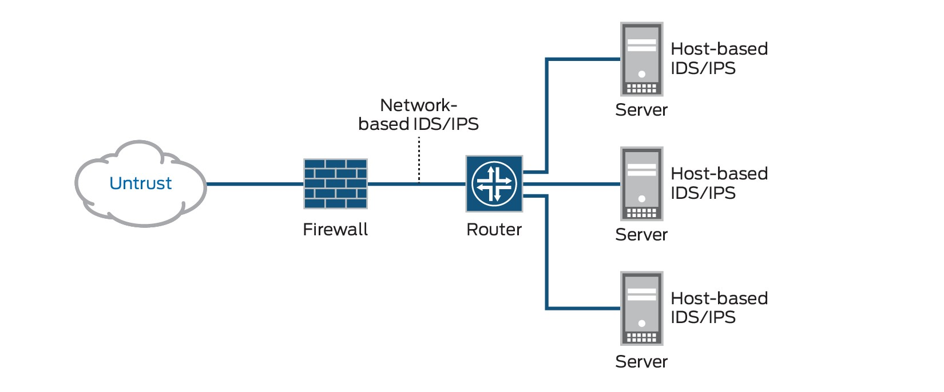
Introduction
An IDS is basically a software or device that is categorised into two common parts one is NID i.e. Network Intrusion Detection and second is HID i.e. Host Intrusion Detection. The work of both the NID & HID is same but their level is different. But IDS are categorised into 5 types – NIDS, HIDS, PIDS, Hybrid IDS & APIDS. Work is same to detect intrusions but they are used at different levels.

Slide 3
Problem Statement
A layout of the network should be made prior to the implementation of IDS as I’m implementing NIDS. There are various parameters which are to be kept in mind while I designed network and configure IDS. Here are some ‘can’s and ‘can not’s about the IDS.
CAN recognize and report alterations to data.
CAN detect when your system is under attack.
CAN detect errors in your system configuration.
CAN NOT analyse all the traffic on a busy network.
CAN NOT prevent system from that attack which it detects.
CAN NOT deal with some of the modern network hardware and features.

Slide 4
Motivation
When we had all individually registered for this project none of us were quite sure what and how to implement IDS and what planning should be done to complete this project. But we all knew we wanted to do something interesting and most importantly something fun.
We have seen some of the networking projects but all those were of basic level and we somehow knew all the basics of networking and worked under some basic projects so we decided to do some intermediate level.
This IDS has many projects including the expert mode where some high level commands are used but if I talk about network security we all were new so we picked from basic IDS security that how it worked and secure the network.

Slide 5
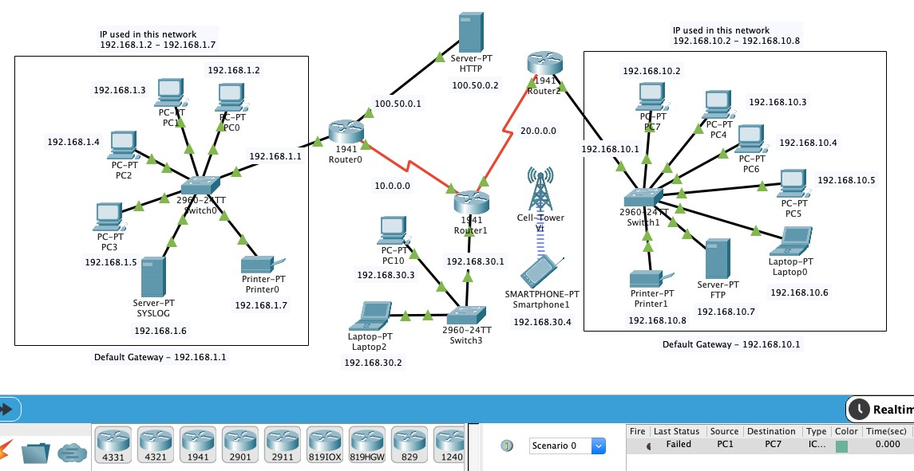
Network Architecture
Placing the devices and connecting it with cables is not enough! We have to do far more than this. After connecting with cables first task is to assign them IP addresses.
After assigning IP to each interface in the network. Next step is to check connectivity from one PC to another. But here connectivity only works inside the network, our network is still not capable of communicating with outside PCs

Slide 6
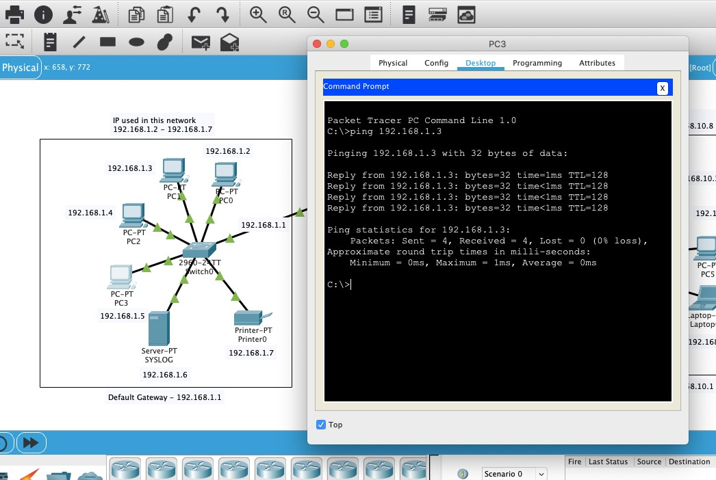
Methodology
The research employed a real-time simulation mode available in Cisco Packet Tracer to develop and test the prototype network design.
The network design focused on establishing secure connections and optimizing data transmission speed.

Slide 7
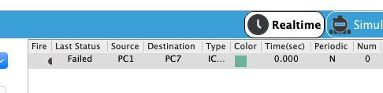
Project Implementation
Configuring the Network
Placing the devices and connecting it with cables is not enough! We have to do far more than this. After connecting with cables first task is to assign them IP addresses. As discussed above Class A and C IPv4 are used. After assigning IP to each interface in the network. Next step is to check connectivity from one PC to another. But here connectivity only works inside the network, our network is still not capable of communicating with outside PCs

Slide 8
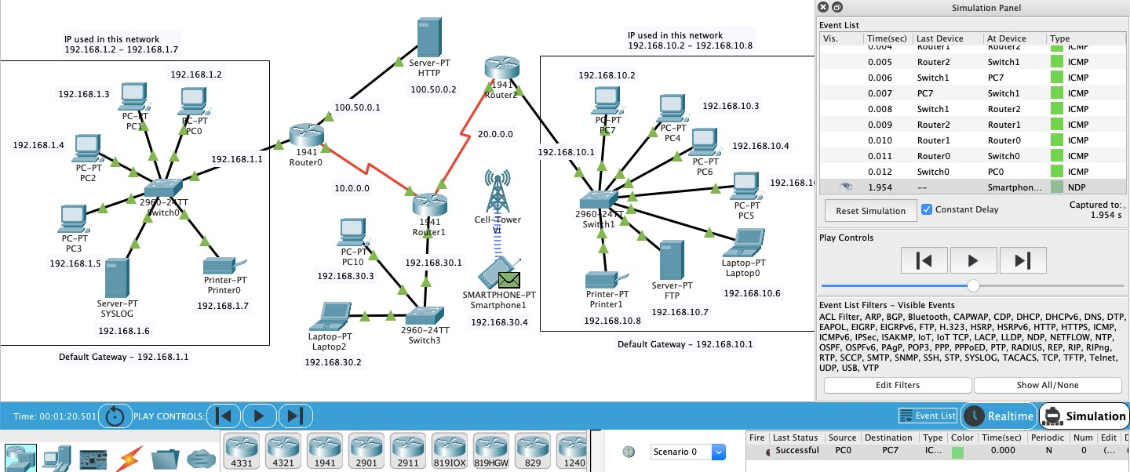
Protocol Used
Testing the Network
Before moving towards the implementation of IDS. It is important to test the connectivity of the entire network. In this a Packet is sent to PC7 from PC1 and acknowledgement of that packet is received back to the PC1 and the whole process is successfully completed.

Slide 9
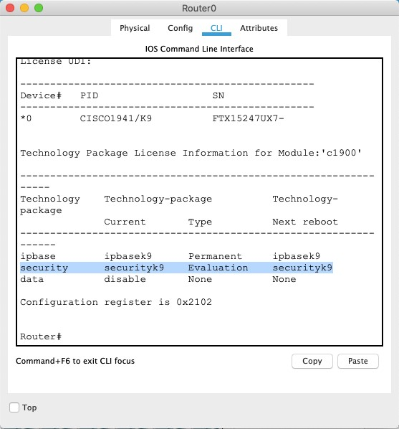
Implementation of NIDS using CLI For implementing IDS on router0 we have to firstly activate security package of that router. We have activated ‘securityk9’ package

Slide 10
Commands for Implementing IDS
There are different commands used for implementing and enabling IDS on that specific interface.
Commands | Description
enable | It is used to enable the networking device.
config t | It will enter the device into configuration mode.
show version | It is used to show version of router with some other details and security & data packages.
license boot module c1900 technologypackage securityk9 | It is used to activate the securityk9 package in the router for IDS implementation.
do reload | For reloading the router.
mkdir (directory_name) | Used for make a directory in router
ip ips config location (directory_name) | Assigning the location to store IPS signatures.

Slide 11
Commands
ip ips (name) | For creating a IPS rule
ip ips signature-category | For checking or entering the IPS signature categories.
category all | For entering into all the categories of IPS.
retired true | For retiring a category.
retired false | For unretiring a category.
category (name) basic | For entering into a category which we made earlier as IPS rule. And unretiring all the basic categories of this rule.
int (interface_name) | To enter into an interface.
ip ips (rule_name) out | To apply the IPS signature inward at a interface.
logging on | Turning on the logging capability of the router.
logging host (ip_address) | Assigning the syslog server for logging
service timestamps log datetime msec | To synchronize clock between system clock and log message.
ip ips signature-definition | To enter a specific signature and change the definition of that signature

Slide 12

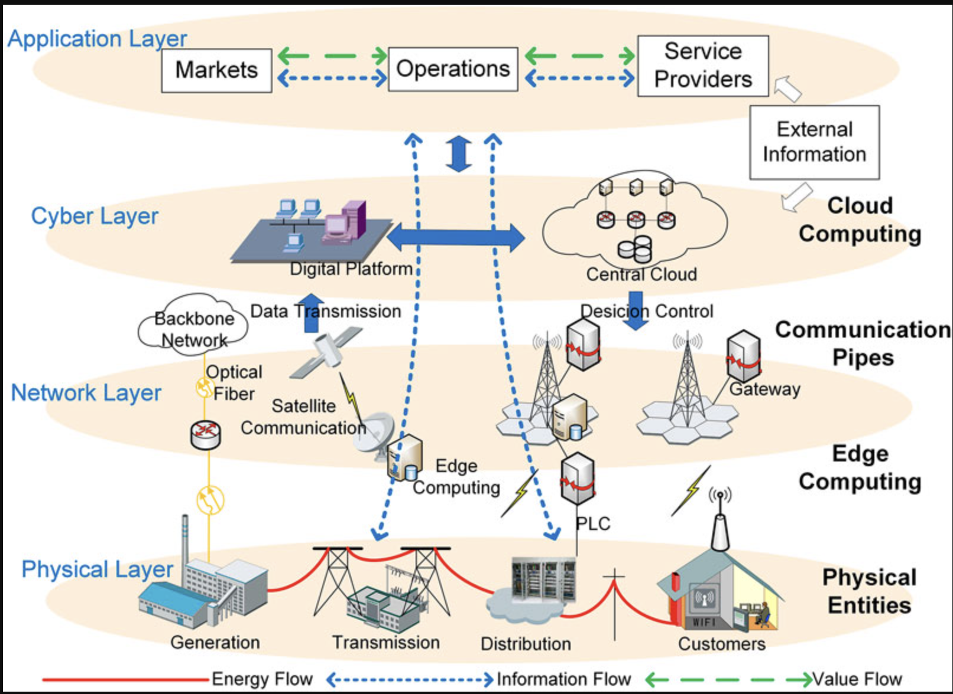
Future Work:
In future reference we need to work on the Honeypot System to implement and work the Intrusion Prevention System along with the Intrusion Detection System.

Slide 13
Summary
An IDS is basically a software or device that is categorised into two common parts one is
NID i.e. Network Intrusion Detection and second is HID. In this project I have implemented
Intrusion Detection System by creating 3 different networks .Implementing the IDS is very challenging task as it needs the implementor to have proper knowledge with prior knowledge with some common and special network devices and ethernet cables Here are some ‘can’s and ‘can not’s about the IDS.
CAN recognize and report alterations to data.
CAN detect when your system is under attack.
CAN detect errors in your system configuration.
CAN NOT analyse all the traffic on a busy network.
CAN NOT prevent system from that attack which it detects.
CAN NOT deal with some of the modern network hardware and features.
The aim of this project was to build a security technique to secure a network for malicious activity. This project was a great learning opportunity for all of us as we come to know some new things which we don’t. There were many difficulties for us during the whole process but we didn’t lose hope and tried to complete this as soon as possible.

Slide 14
Thankyou

